Slide 1
Multi-Processing
-Susan Lama

Slide 2
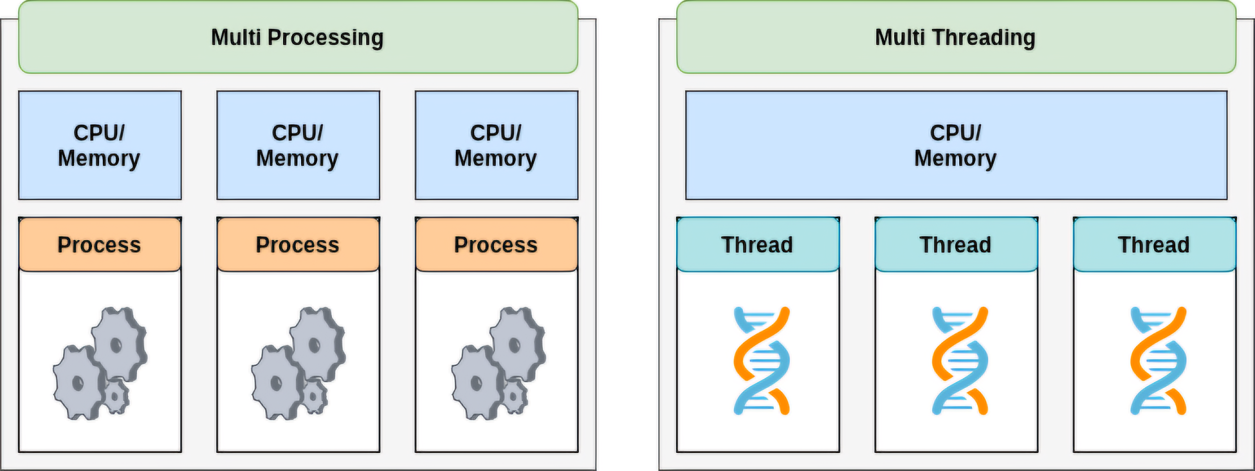
Program = Set of instructions.
Process = Program in execution, doing the actual task.
Thread = Small tasks or units of execution within a process, performing parts of the larger task.

Slide 3
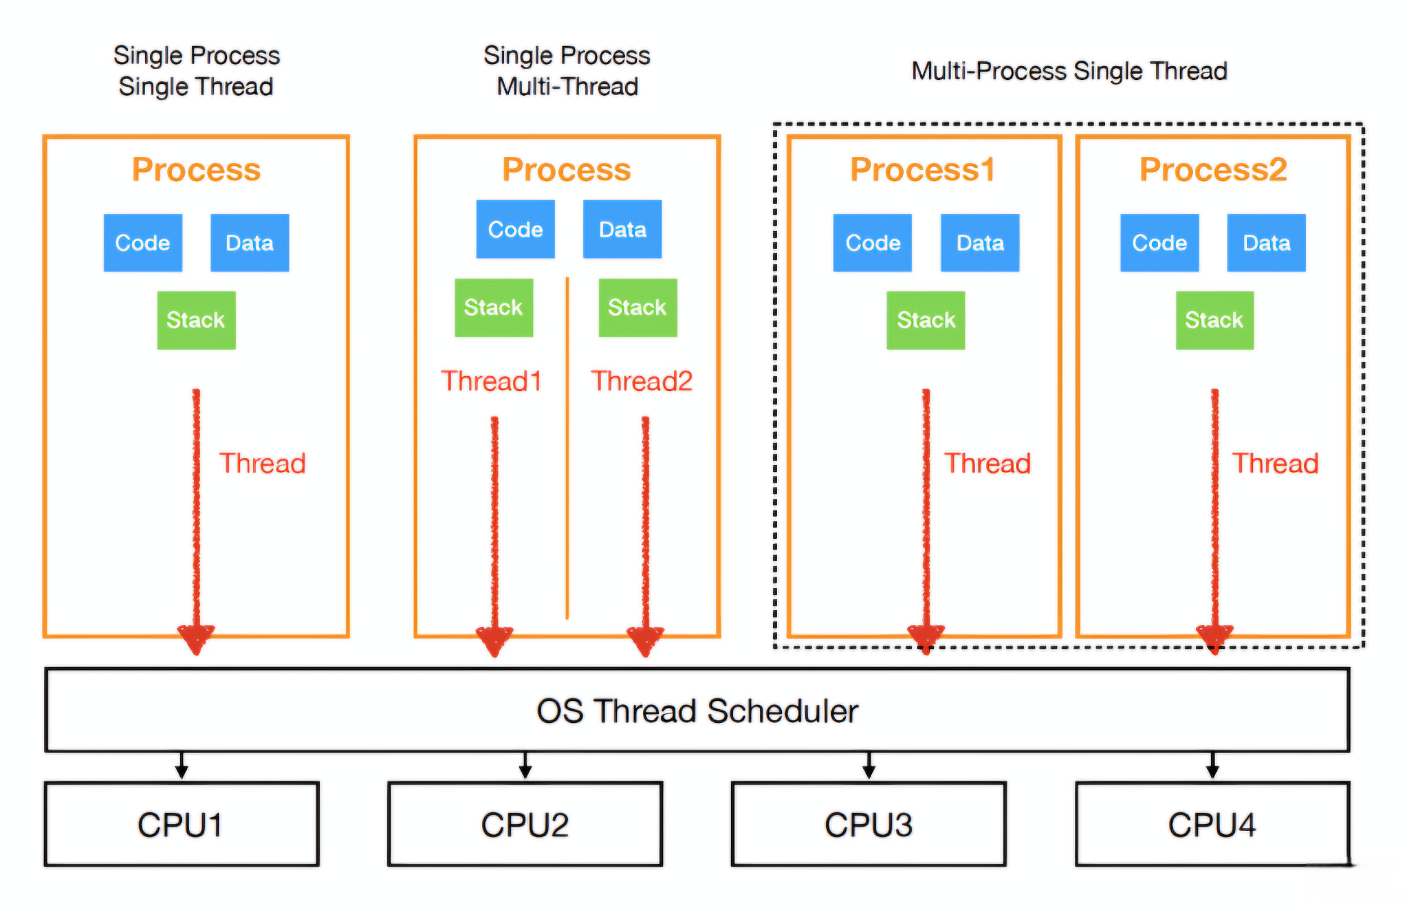

Slide 4
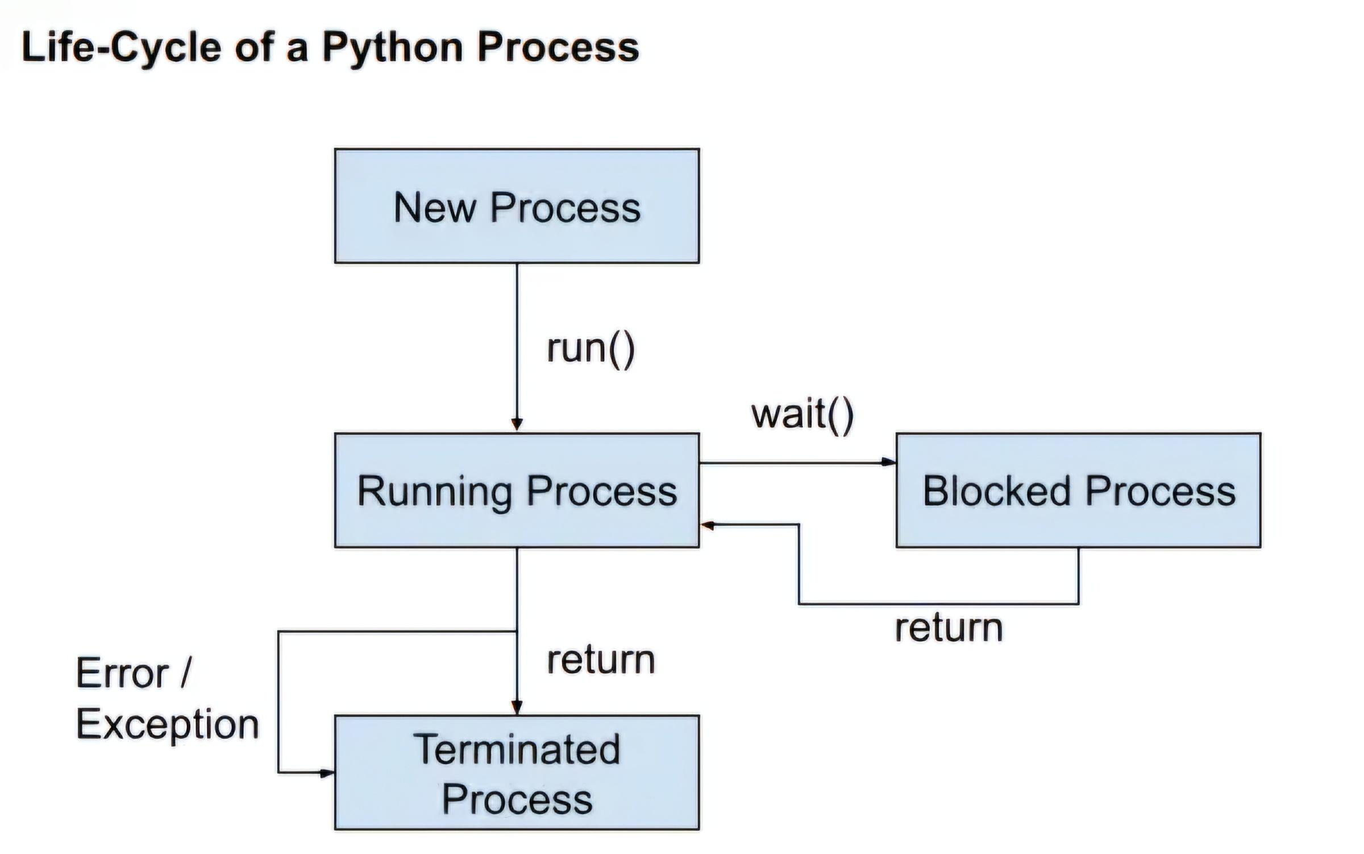

Slide 5
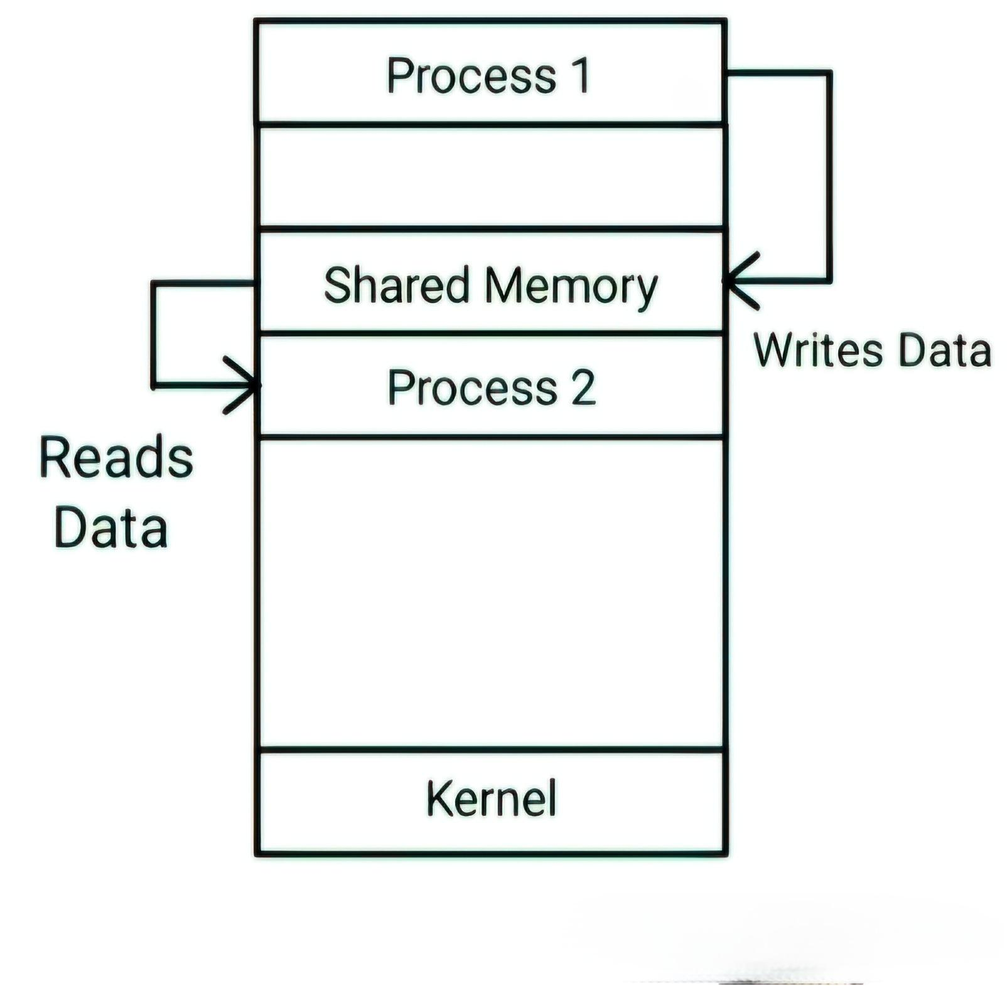
Fig: IPC using Shared Memory

Slide 6
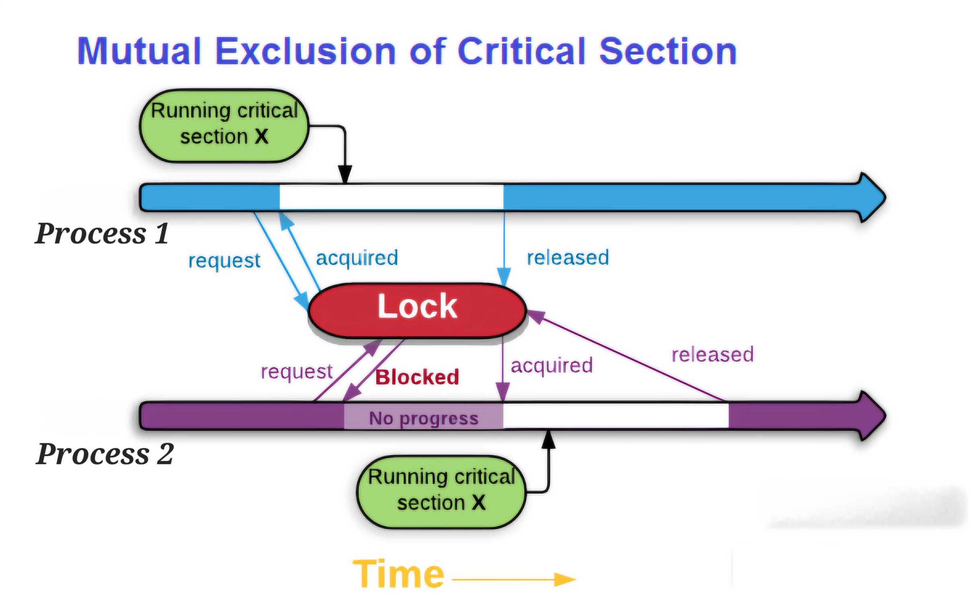

Slide 7
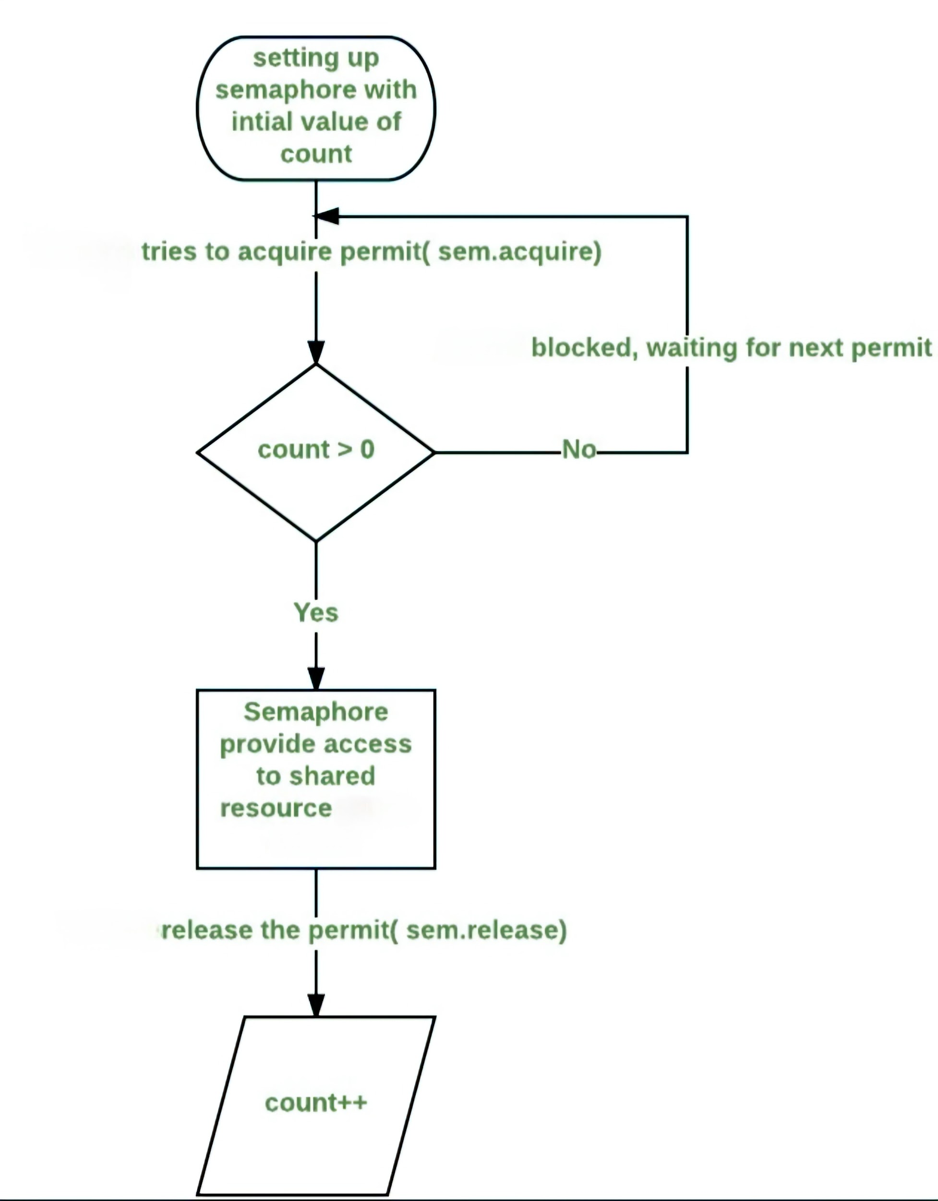
Fig: Working of Semaphore

Slide 8
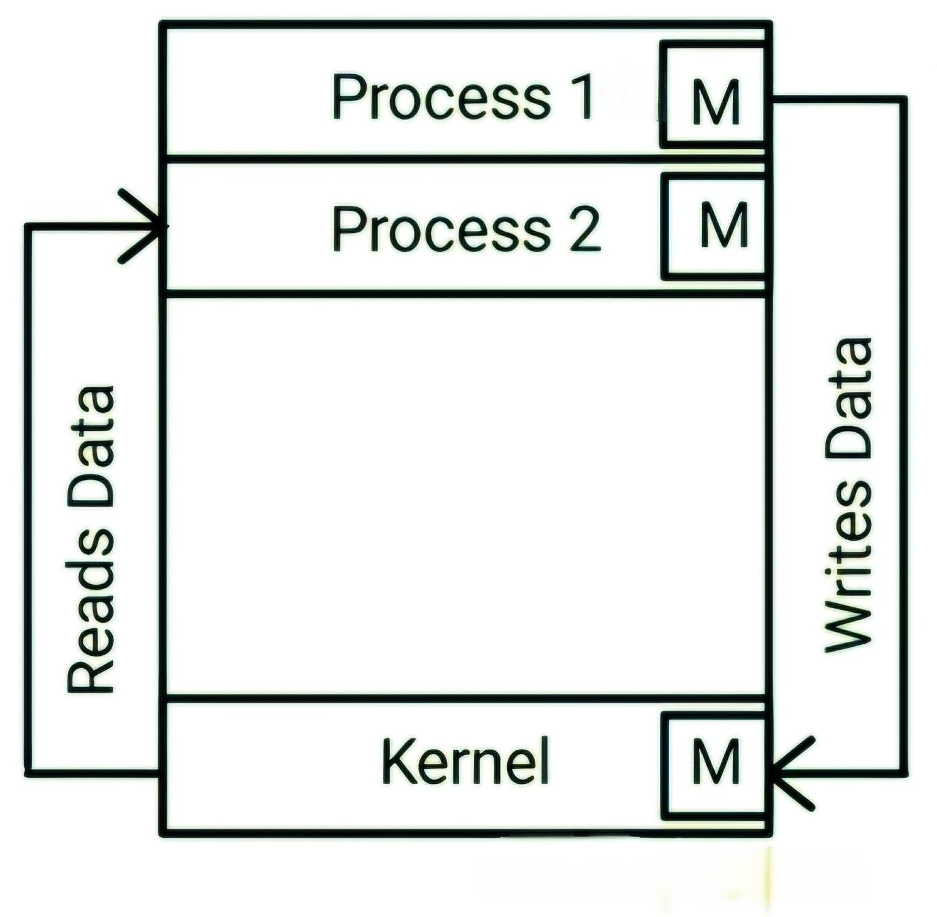
Fig: IPC using Message Passing

Slide 9
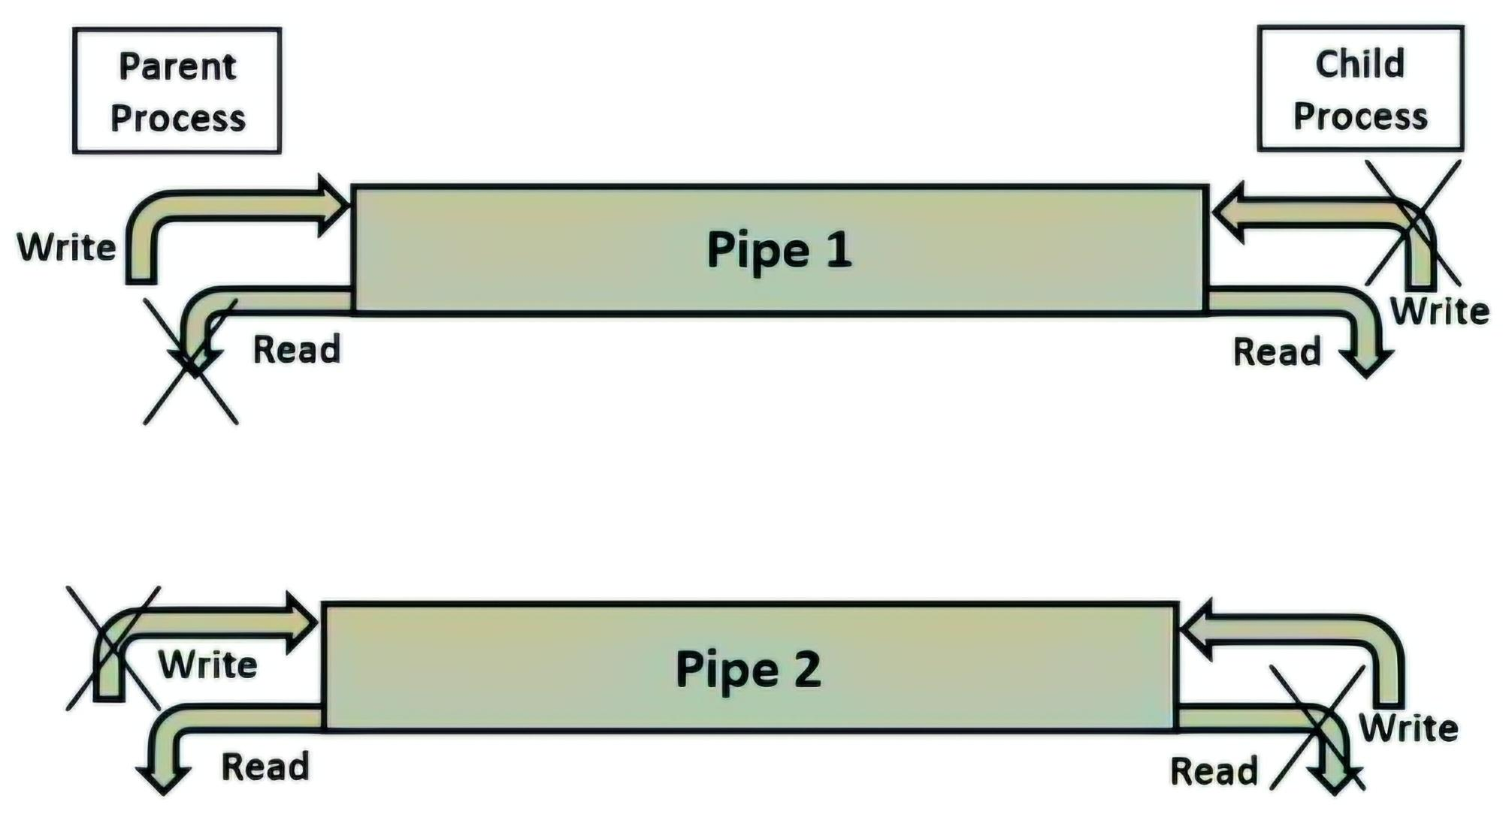
Fig: IPC using Pipe

Slide 10
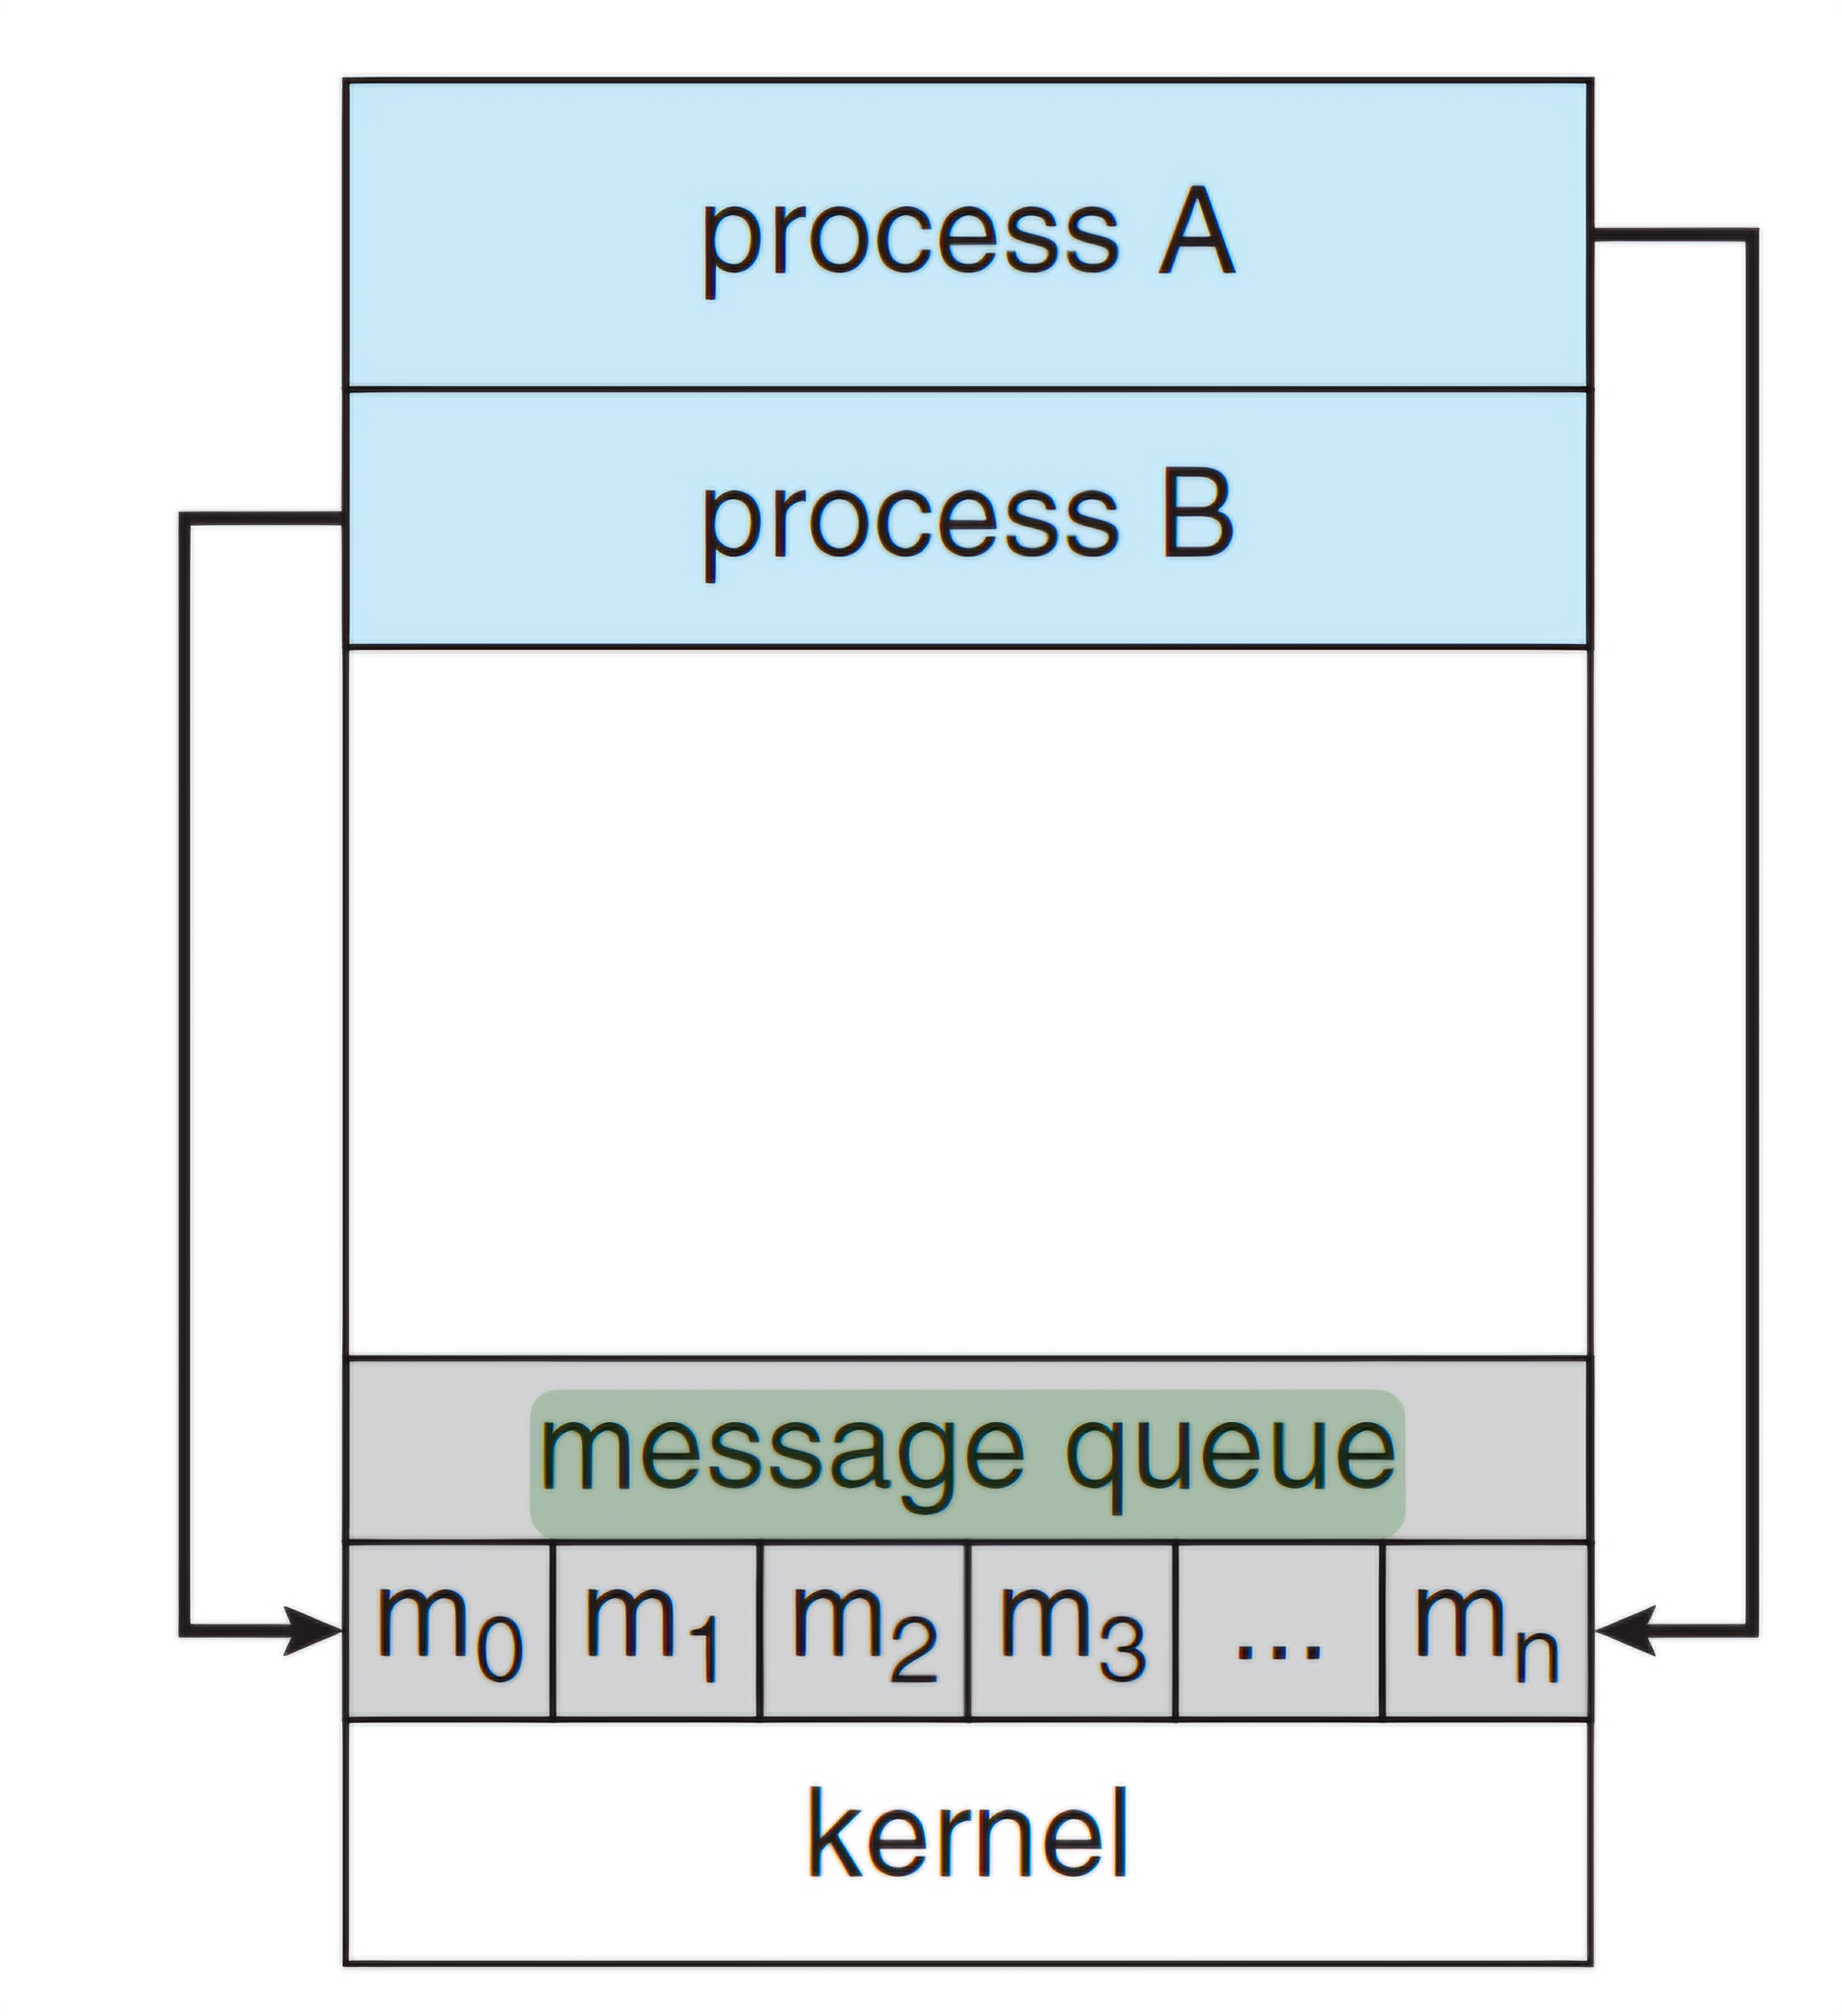
Fig: IPC using Message Queue

Slide 11
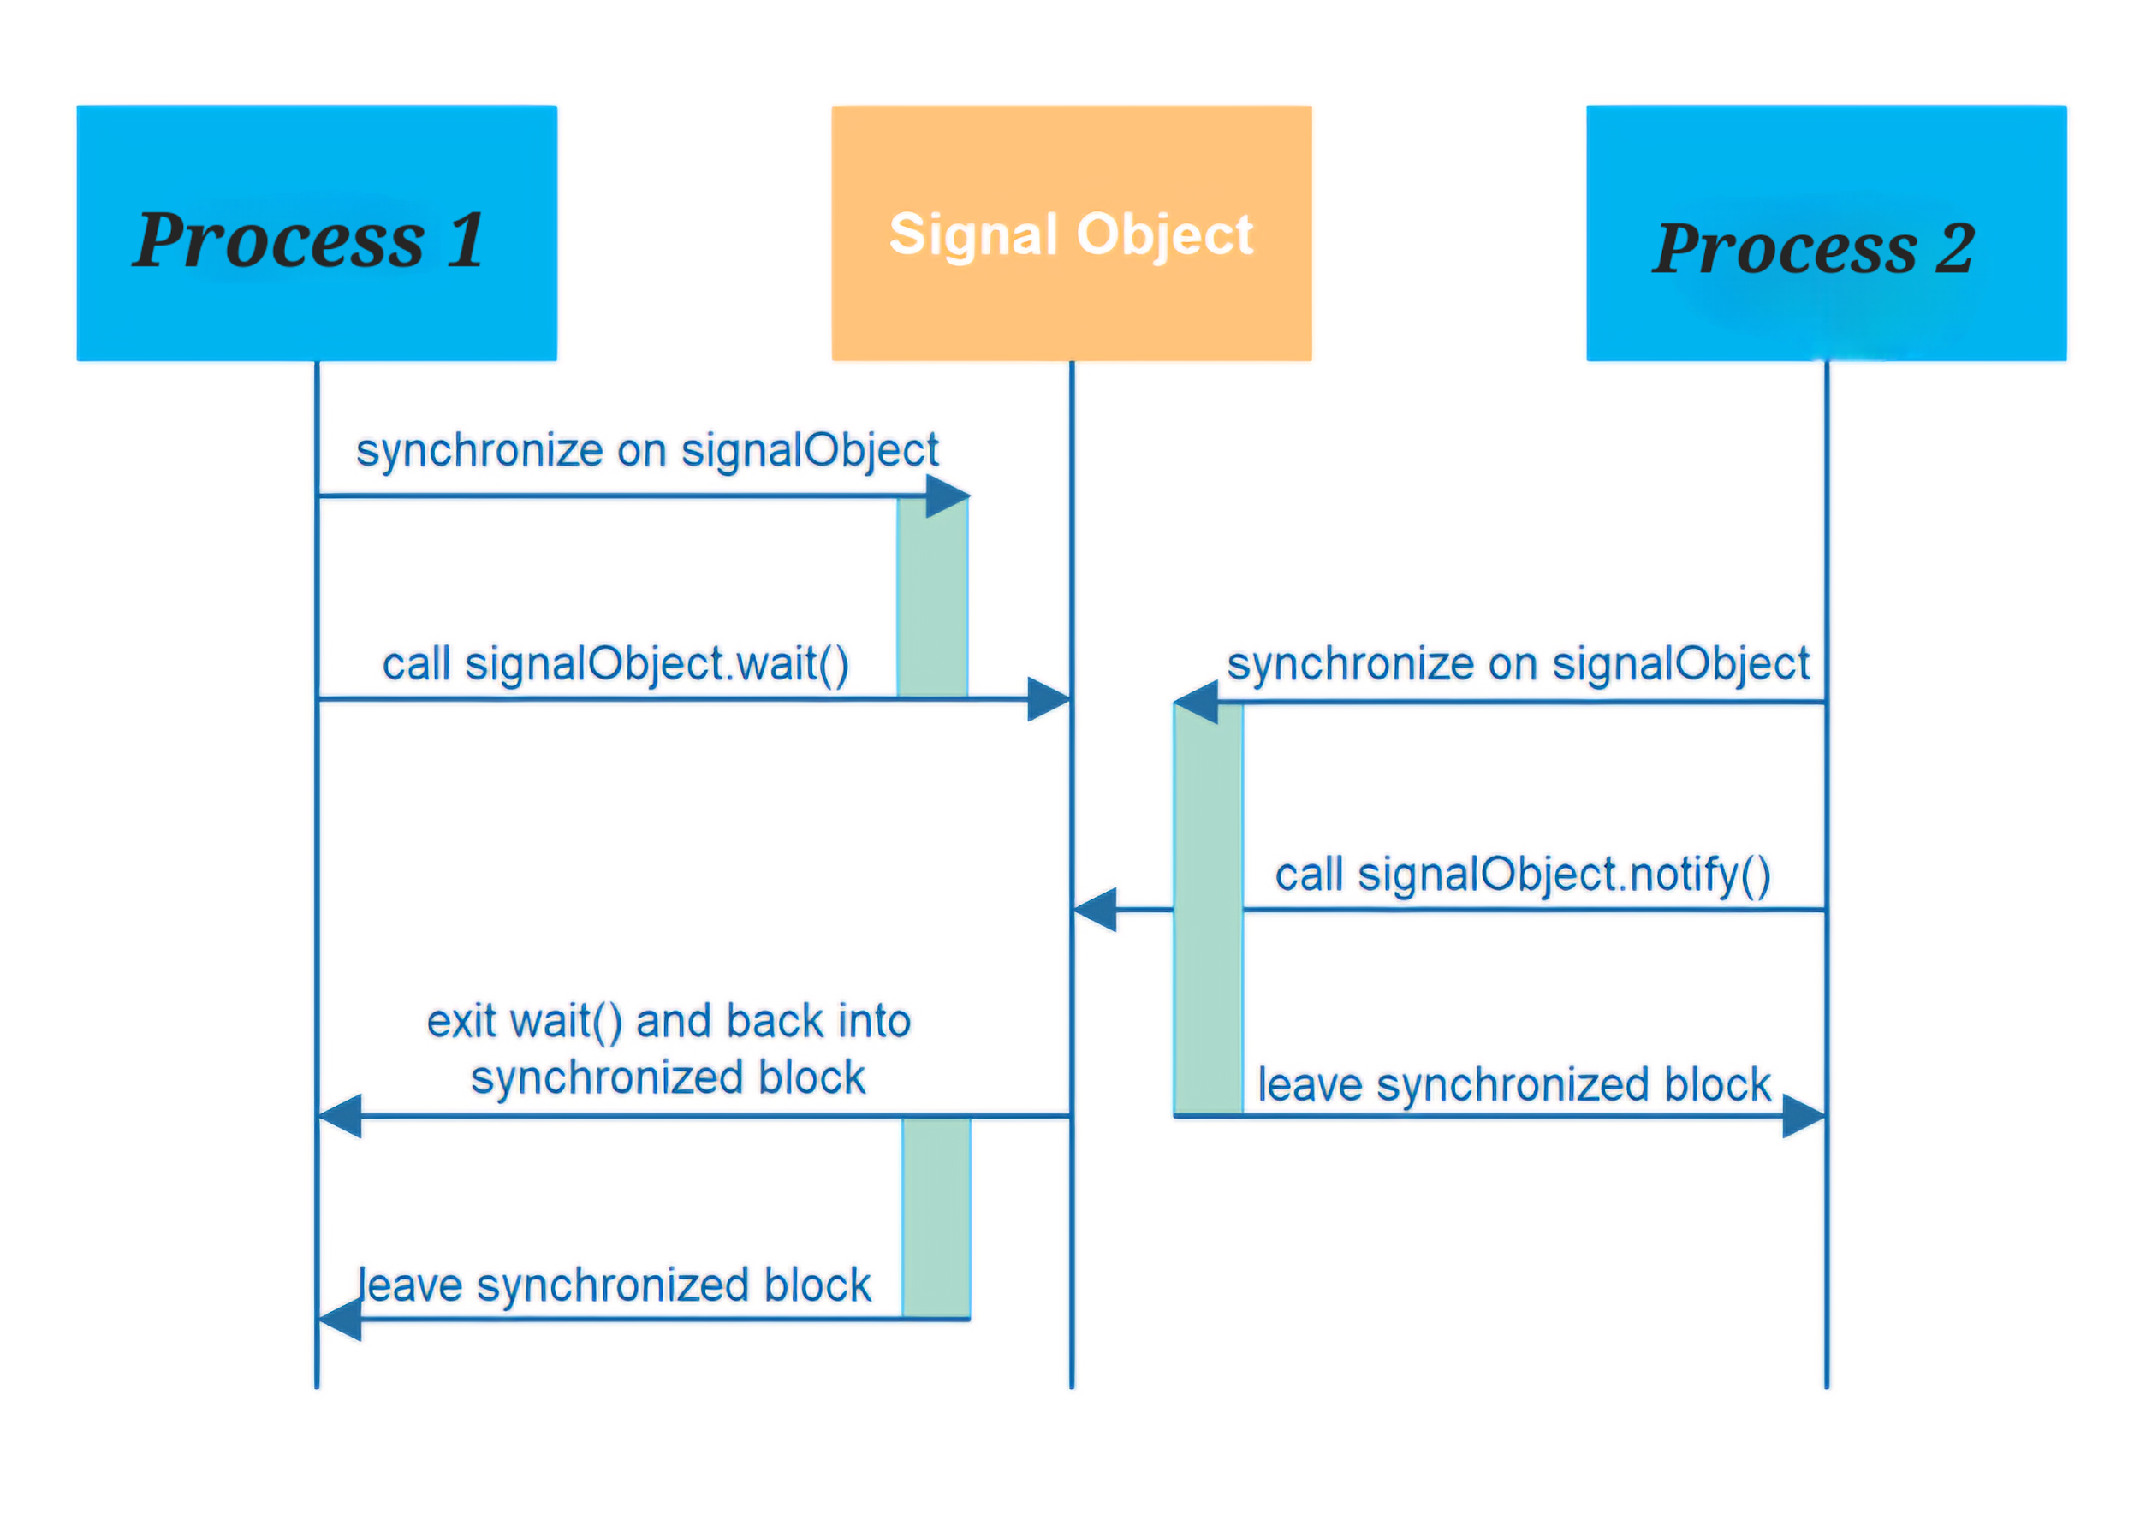
Fig: Process Signaling

Slide 12
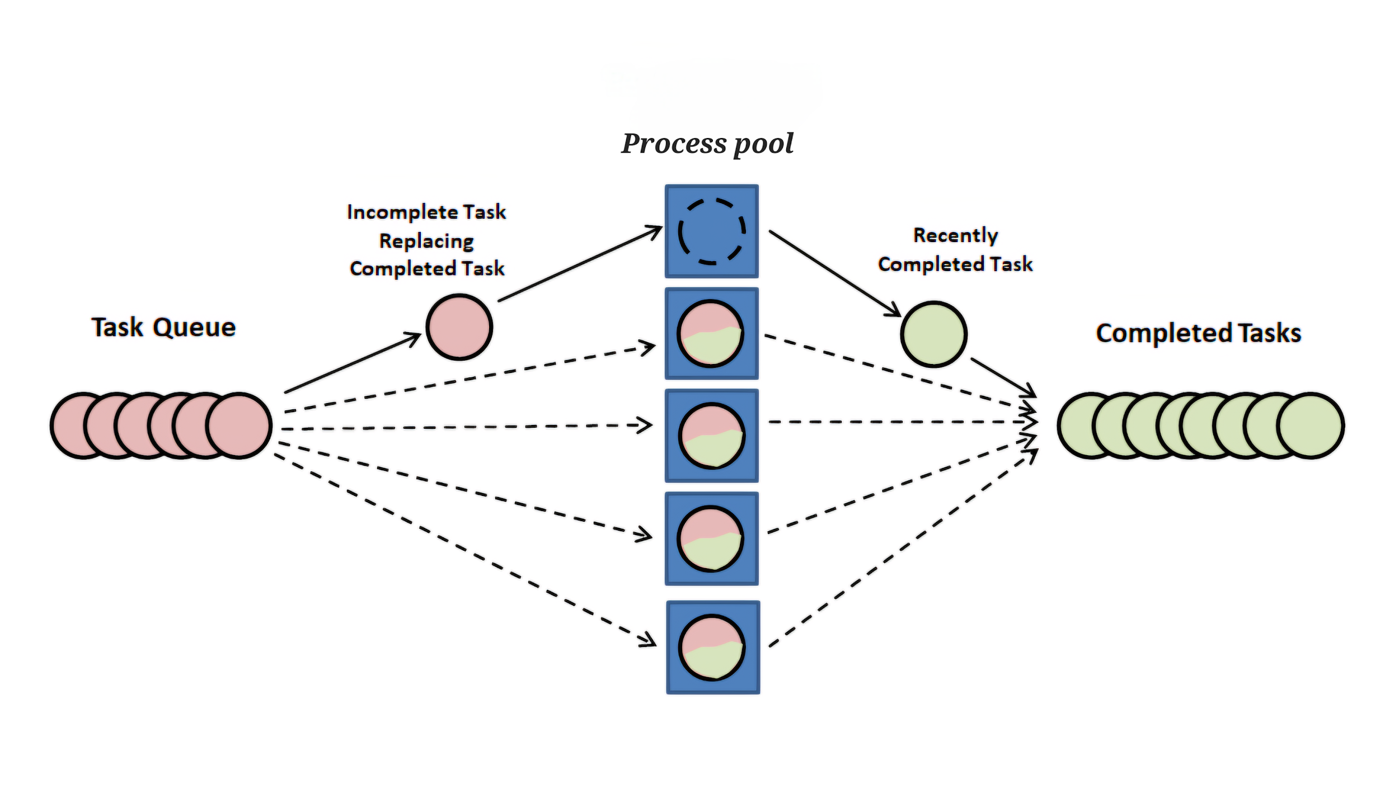
Fig: Process Pool

Slide 13
References:
MultiProcessing- Documentation
superfastpython.com
Youtube- LucidProgramming (MultiProcessing)
Youtube- Indian Pythonista (MultiProcessing)
Youtube- Neso Academy (InterProcessCommunication)

Slide 14
Thank You

